Slide 1
Designing Phase
Of
Student Registration System
Group: CS_IS_A01
Presenters: Noor Ahmad & Muhibullah
Date: 1396-01-31
1

Slide 2
Scenarios for Use Case Diagrams
Use Case Name | Log in
Author | KhayalBacha
Last Revision | 20 April 2017
Actors | User and Administrator
Uses | Login Info
Extends | UserInfo
Pre-Conditions | All users information will available in system.
Basics Course / Main Scenarios | 1. User Enter Username and password and gets enter to the system. 1.2 Users will have their own username and password and Administrator will have his own username and password. 2.1. System checks, is the user registered or not? 2.2. System also checks username and Password. 3. When user logged into the system, system will open the main page. 4.1. User will select new student, if student is a new student. 4.2. User will select edit student, if student want to edit his record. 5. New user will add through Admin.
Other Scenarios | 2.1. If the user isn’t registered, then the system will alert a message to register the user.
Post-Conditions | When Username and Password entered, then Login will successful.
Error-Conditions | 2.2. If the username or password isn’t correct, then system will generate an error.
2

Slide 3
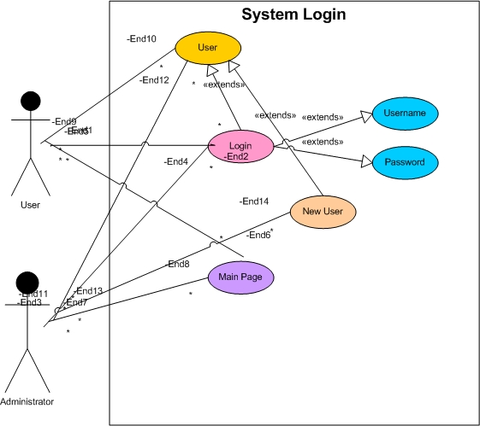
Use Case Diagram Login System
3

Slide 4
Scenarios for Use Case Diagrams
Use Case Name | Student Registration
Author | KhayalBacha
Last Revision | 20 April 2017
Actors | User, Administrator
Uses | Login Account
Extends | Nil.
Pre-Conditions | Student Registration form and records of all registered students will available in System.
Basics Course / Main Scenarios | 1. System prompts the user to add new student or edit registered student record. 2. User selects one of them. 2.1. If user select new student, then system will open the new registration form to user. 2.2. If user want to edit the record of a student, then system will ask for Student ID Number to find out the student. 3. When user fill out the new registration form, system will display the complete record to user. 4. System will provide service of report generation for users. 5. System will contain record searching method. 6. User make the backup of the system.
Other Scenarios | 2.1. User will fill all fields of form.
Post-Conditions | Form is composed and ready for registration.
Error-Conditions | 2.2. Is a student not available, then the system will alert to the user.
4

Slide 5
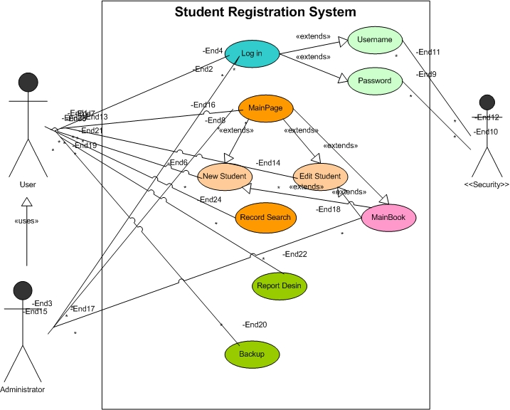
Use Case Diagram For Student Registration System
5

Slide 6
Scenario for Class Diagram
This system (Student Registration System) will contain the following Classes.
(The system contain an interface, which name in StdFunction.
This interface will have two methods:
StdSet (); (This method will set values to all attributes)
StdDisp (); (This method will display us all we need)
System Classes and their related attributes are as follows:
6

Slide 7
Cont.….
S.No | Class Name | Attributes
1 | StdInfo | ID: long{Unique} Name: String FName: String GFName: String Age: int SSN: long Nationality: String FJob: String NLang: String Year: Date Image: Blob
2 | StdDetails | Gender: String
3 | StdAddress | Province: String District: String Village: String
4 | StdRelative | Brother: String Uncle: String MUncle: String UncleSon: String MUncleSon: String
5 | StdSchoolProfile | SchoolName: String Class: int
6 | StdLetter | LetterNo: String{Unique} DOA: Date
7 | User (For System authentication) | ID: int {Unique} Name: String Password: String Post: String
8 | Login (authenticate users) | Name: String Password: String
7

Slide 8
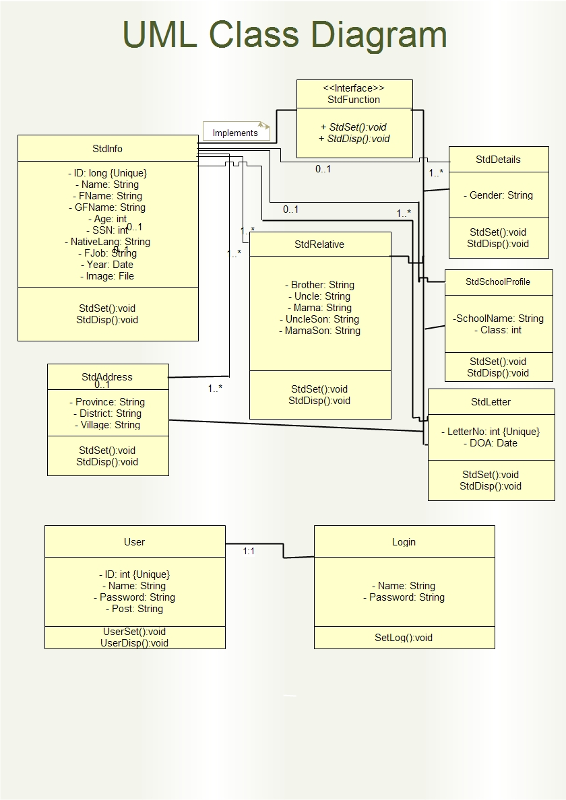
Class Diagram for Student Registration System
8

Slide 9
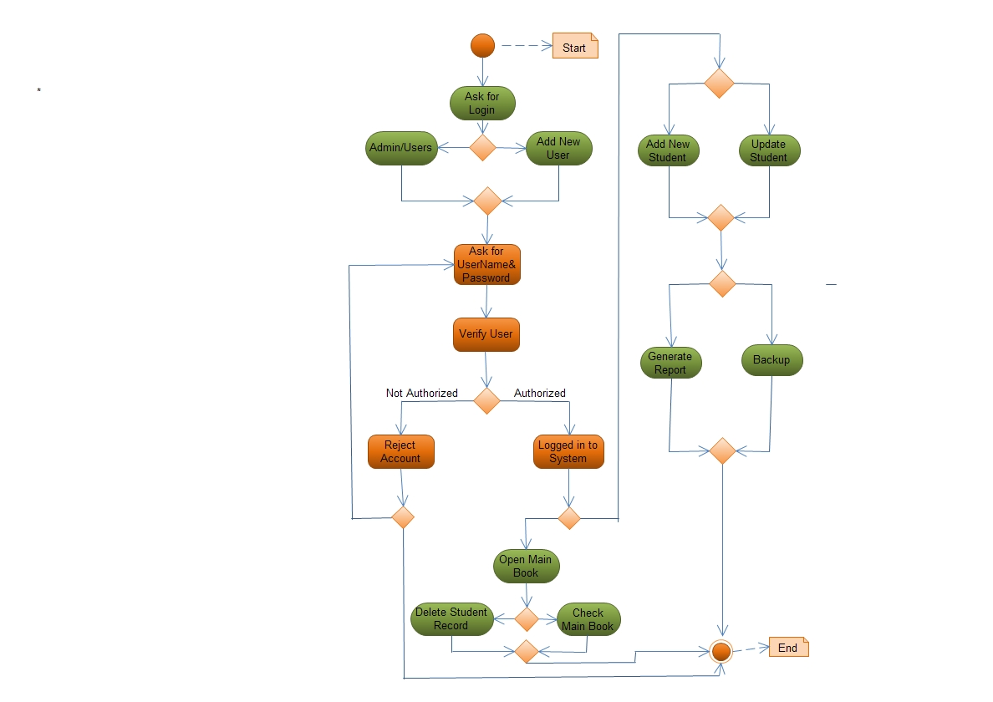
Activity Diagram for Student Registration System
9

Slide 10
Any Question
OR
Suggestion
???????
10

